Slide 1

Online health status detection of a motor
MAS513-Advanced Robotics project:
PROBLEM: Is it possible to determine the health status of the motor continuously using non-contact sensors and non-destructive testing?
Gianluca Salata, 25/08/2021

Slide 2
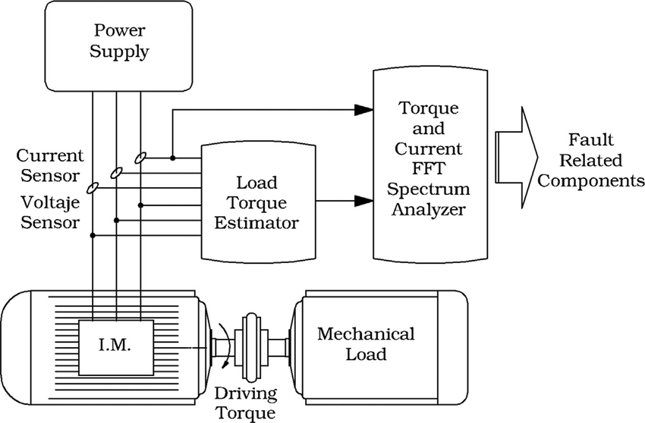
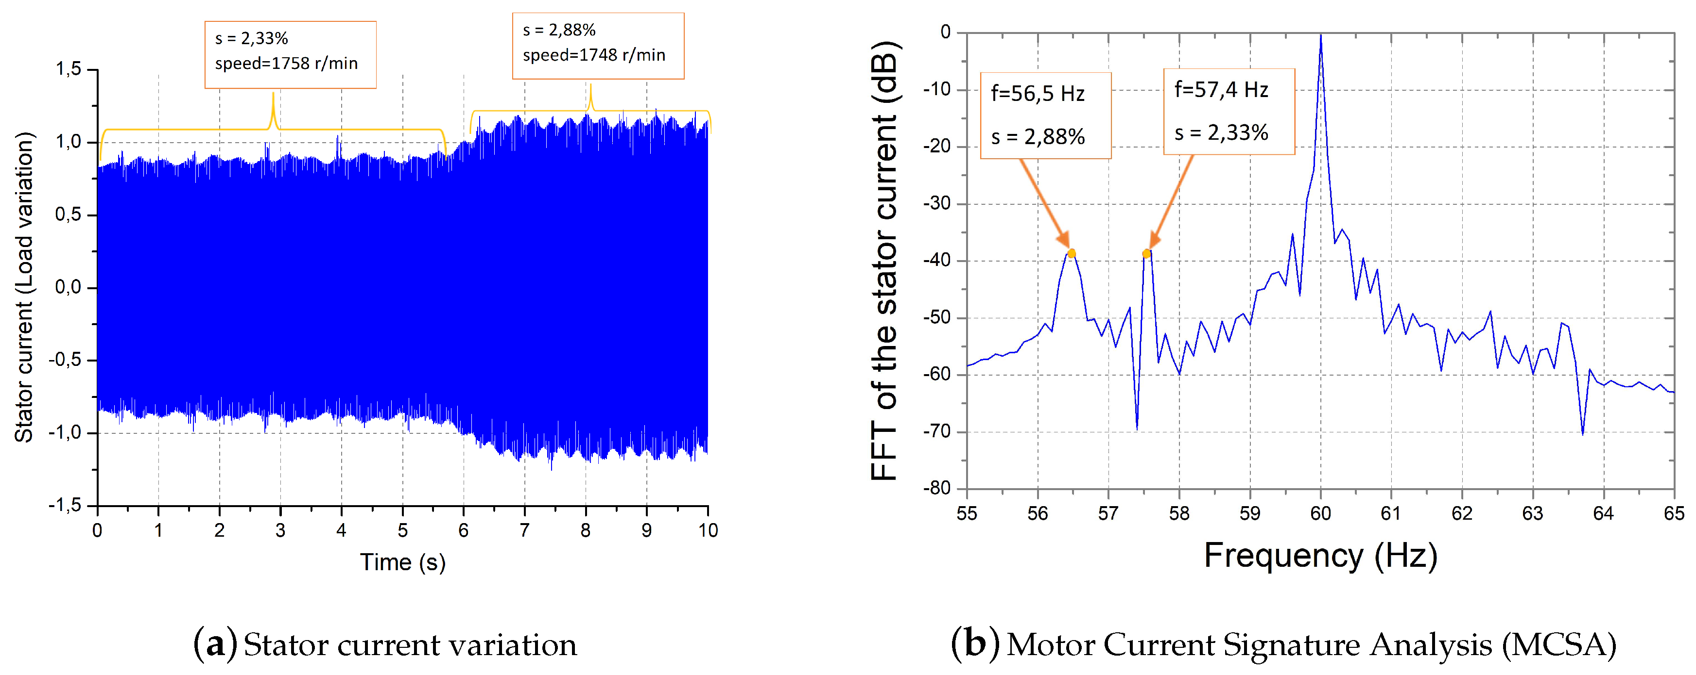


State of art:
The most common technique for the detection of the health status use contact sensor like as
Vibrometer/accelerometer
Voltmeter and ammeters
All of them are base on the key concept that:
Each fault is related to a precise harmonic in the spectrum
1) MCSA(motor current signature analysis)
This method require to measure the variation of the absorbed current from the motor.
From the current spectra is able to identify motor’s fault thanks to a specific relationship.
For example, the frequency related to an air gap(eccentricity):
$$f_{\text{ecc}}=\left\{\left(R±n_{d}\right)\left(\frac{1−s}{p}\right)±n_{ωs}\right\}f_{0}$$
Gianluca Salata, 08/09/2021

Slide 3
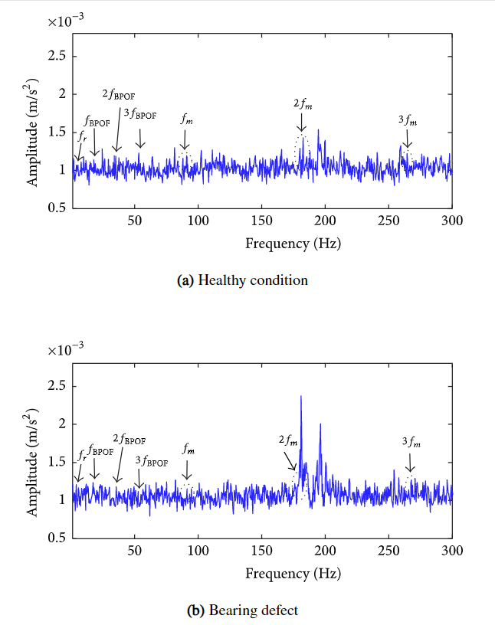

State of art:
2) Vibration analysis
Usually It is based on 3-axis MEMS accelerometers that measure the vibration of the shaft. Also in this case is possible to find fault analysing the spectrum of the displacement of the shaft.
An outer race bearing defect is related a to the characteristic frequency:
Requires bearing’s geometry
Gianluca Salata, 08/09/2021
Notes:
Figure 7(a) it is possible to notice that the fault-related frequencies have low amplitude in comparison with all of the others spectra, especially the gearbox frequencies. In the presence of the bearing fault when the gear is in a good condition as Figure 7(b) shows, the amplitudes of the frequencies remain on the same approximated level. However, the appearance of frequency components in both spectra is inevitable in the closest region to the mesh frequency sidebands and its harmonics.
ball pass outer race frequency ( Hz),

Slide 4
State of art:
MCSA | Vibration analysis
non-invasive | independent of the type of motor power supply
Easy to implement | low power consumption
low signal-to-noise ratio | Lower realiability
contact-sensors | contact-sensors
Gianluca Salata, 08/09/2021
Notes:
Figure 7(a) it is possible to notice that the fault-related frequencies have low amplitude in comparison with all of the others spectra, especially the gearbox frequencies. In the presence of the bearing fault when the gear is in a good condition as Figure 7(b) shows, the amplitudes of the frequencies remain on the same approximated level. However, the appearance of frequency components in both spectra is inevitable in the closest region to the mesh frequency sidebands and its harmonics.
ball pass outer race frequency ( Hz),

Slide 5
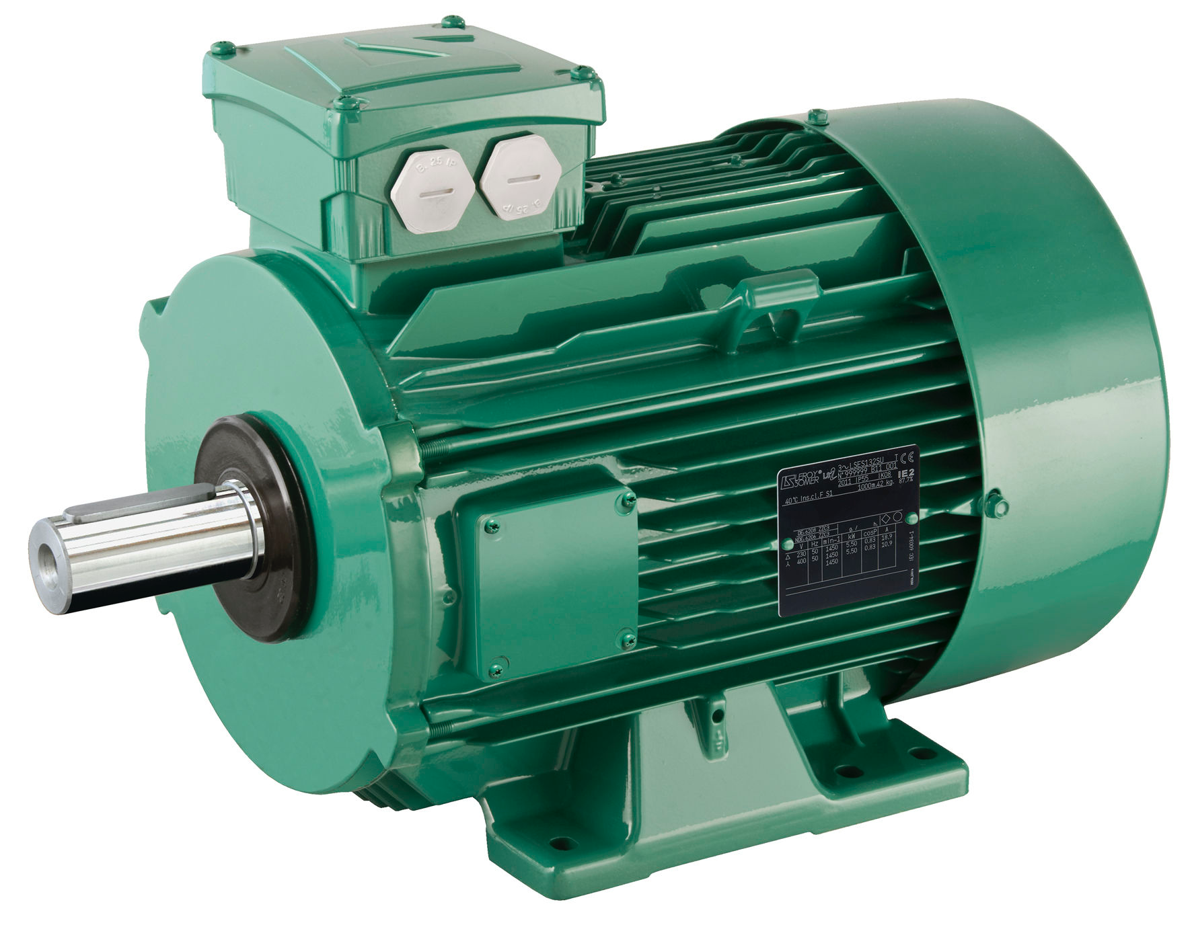
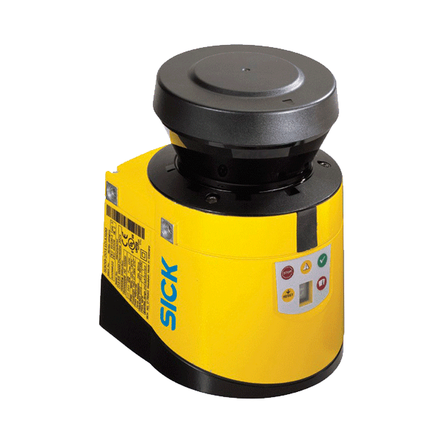
Project’s aim
The aim is to determine the continous health status of the motor using a Lidar that measure the vibration of the shaft.
PROS:
Non intrusive monitoring system
Mostly independent from enviroment condition
Retrace the fault
CONS:
Exspensive
More complex
Assumptions:
Only one fault can occur for each run (NO multiple-fault diagnosis)
Only air between the Lidar and the target
Consider only one direction vibration
PC
Fault …
Gianluca Salata, 08/09/2021

Slide 6
Process
CWFM Lidar generates a voltage signal
Acquisition
Filtration
Fourier trasformaton o of the signal to obtain the range o the shaft
Validations of known equation injecting known fault
PC
Analysing harmonics of the displacement to detect known fault
Gianluca Salata, 08/09/2021

Slide 7
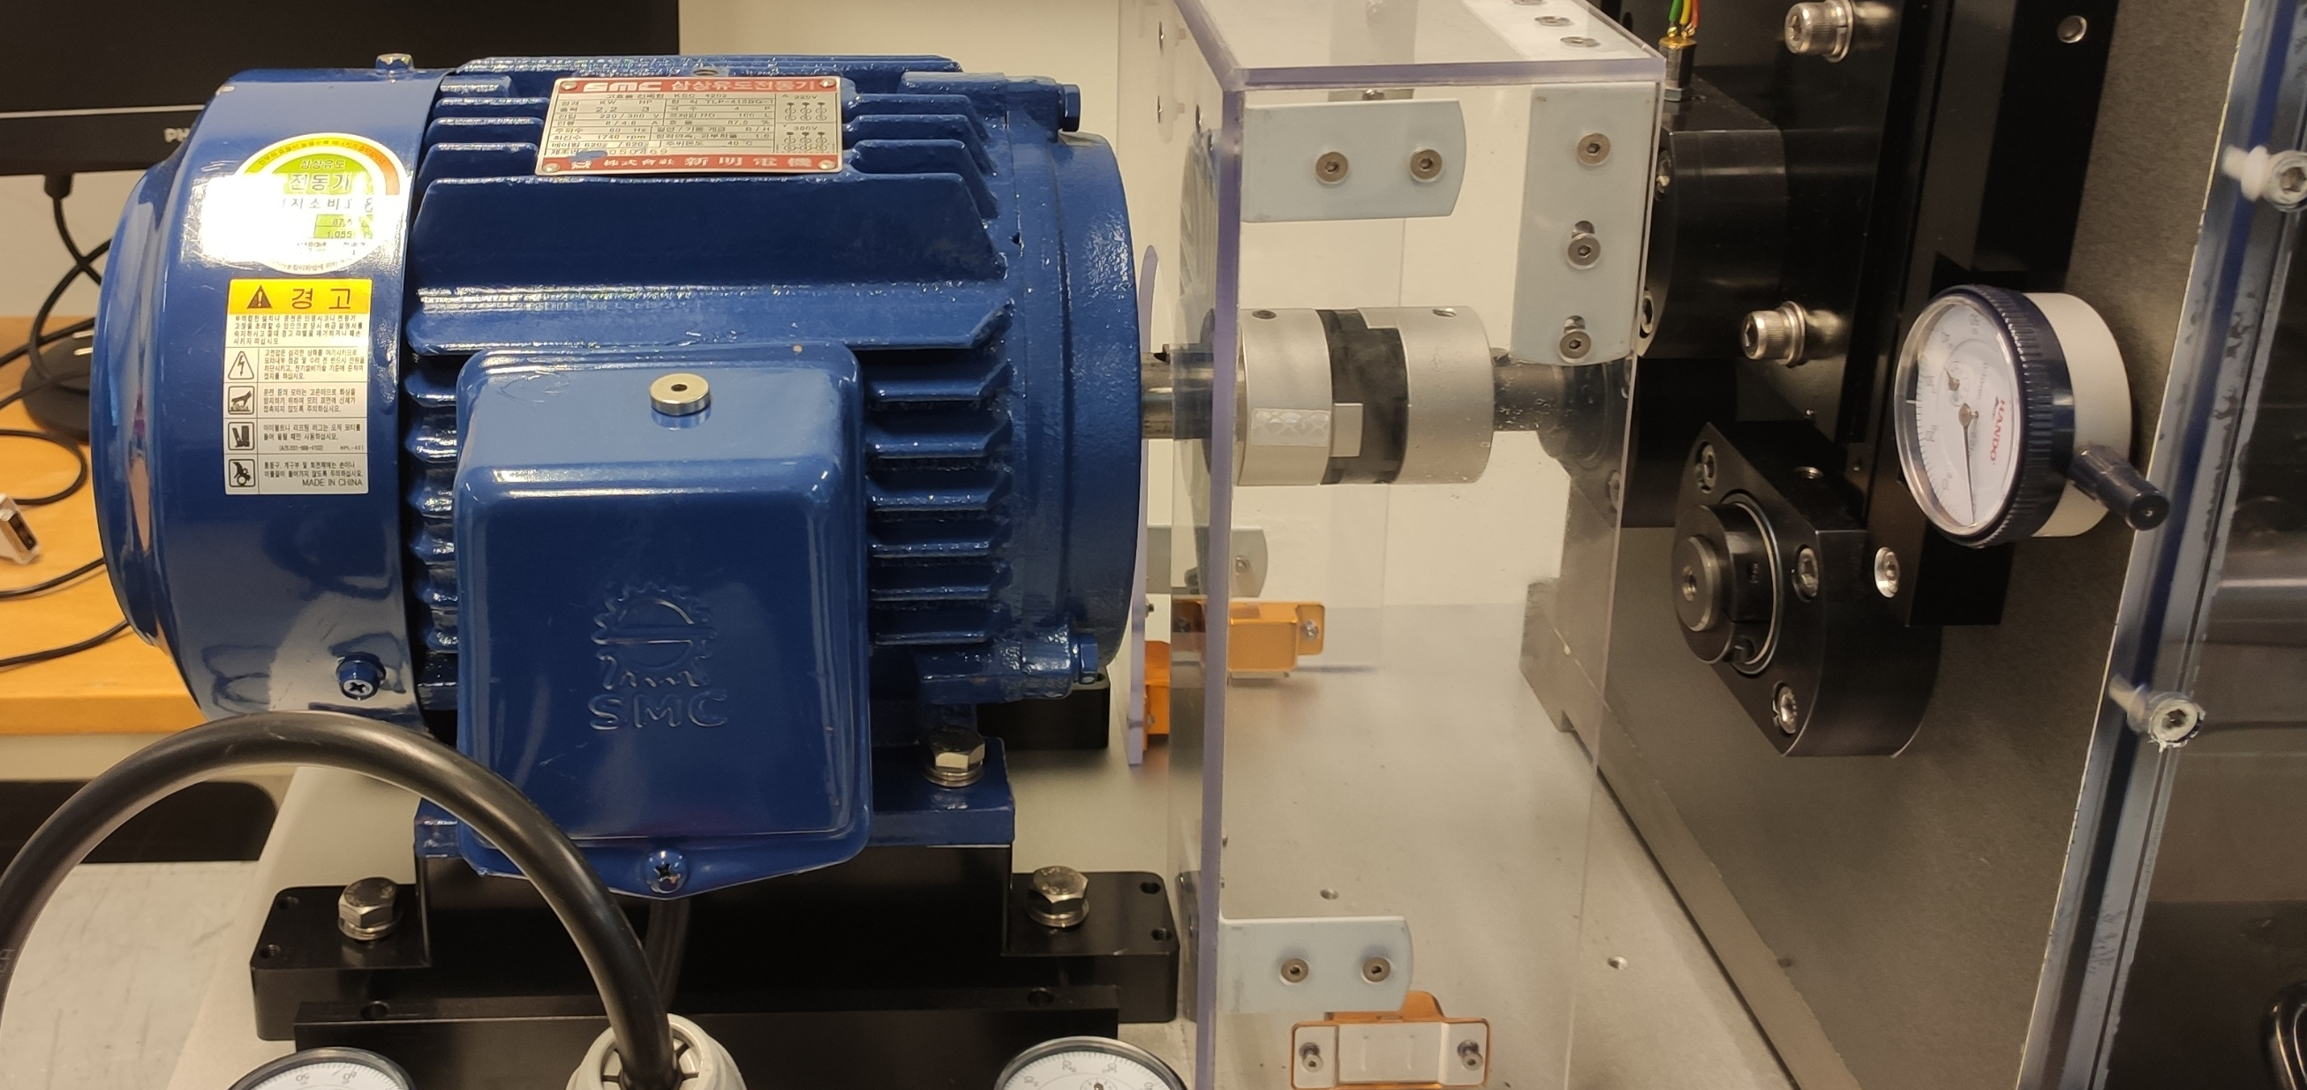
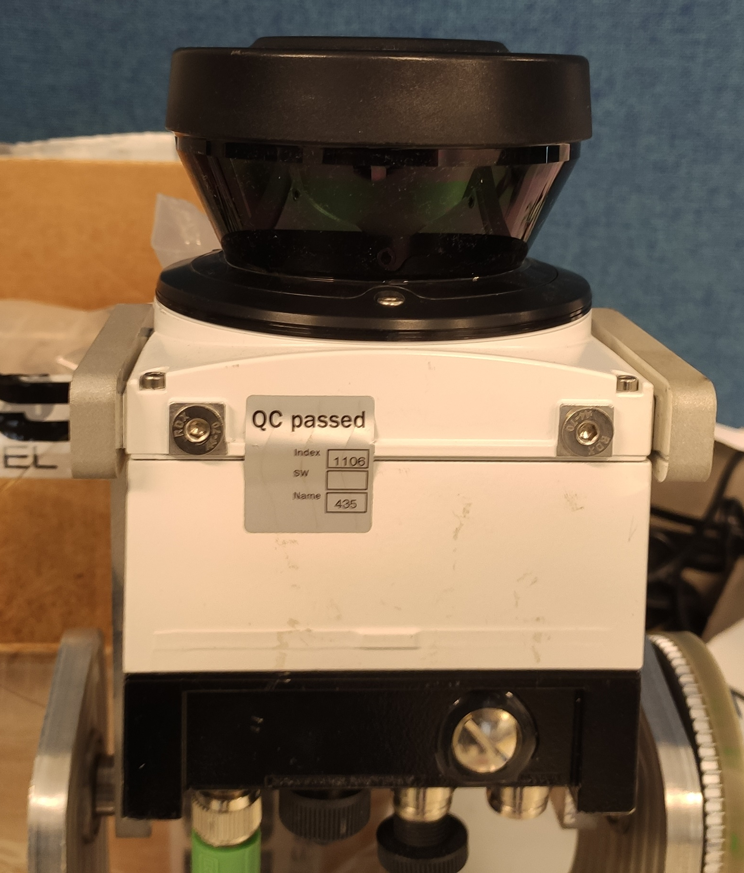
Equipment
Induction motor with variable load
LIDAR LMS133 -10100
Datasheet: here
Gianluca Salata, 08/09/2021

Slide 8
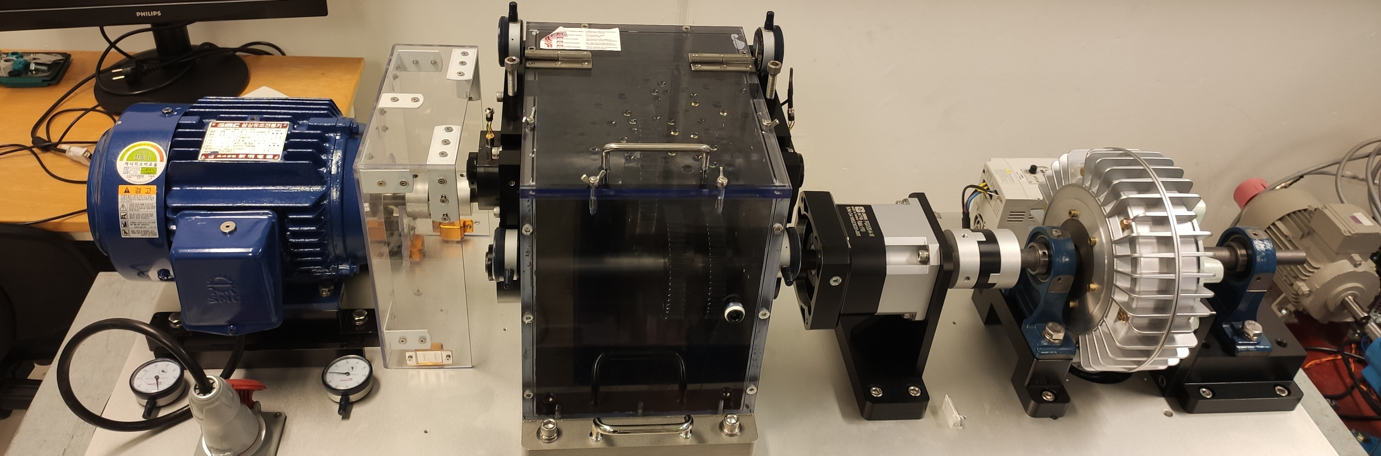
Future applications and developments
The project can be improved introducing multiple-fault diagnosis and multi axes measurements.
Condition monitoring without contact with the object can be very useful when the motor is placed in hostile or not very accesable enviroment.
The data from the sensing components can be used for the control system of the motor, improving efficiency.
Gianluca Salata, 08/09/2021

Slide 9
Thanks for the attention!
Gianluca Salata, 08/09/2021

